Slide 1
Chapter Explores:
Sensors are fundamental building blocks of IoT networks. they are the foundational elements found in smart objects—the “things” in the Internet of Things.
Smart objects are any physical objects that contain embedded technology sense and/or interact with their environment in a meaningful way by being interconnected and enabling communication among themselves or an external agent.
Sensors, Actuators, and Smart Objects.
Defines sensors, actuators, and smart objects and describes how they are the fundamental building blocks of IoT networks
Sensor Networks
Design, drivers for adoption, and deployment challenges of sensor networks.

Slide 2
Sensors
It senses.
Measures some physical quantity and converts that measurement reading into a digital representation.
That digital representation is passed to another device for transformation into useful data that can be consumed by intelligent devices or humans.
Sensors can measure anything worth measuring
Sensors can be readily embedded in any physical objects that are easily connected to the Internet by wired or wireless networks
Sensors can communicate with each other and external systems, they can interpret their environment and help in making intelligent decisions.

Slide 3
Different categories of sensors:
Analog or Digital
Refer the previous slides

Slide 4
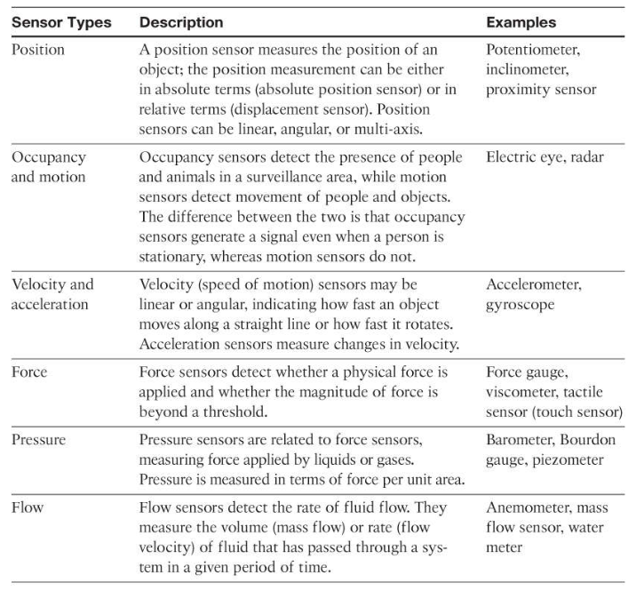

Slide 5
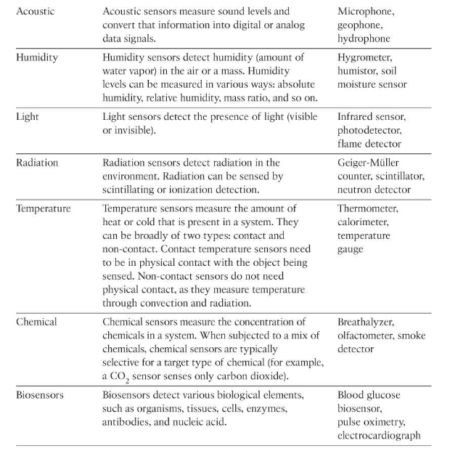

Slide 6
Sensors
Sensors come in all shapes and sizes
Example: Smart Farming
uses a variety of technical advances to improve the
efficiency, sustainability, and profitability of traditional farming practices.
most significant impacts of precision agriculture are those dealing with sensor measurement of a variety of soil characteristics include
real-time measurement of soil quality,
pH levels,
salinity,
toxicity levels,
moisture levels for irrigation planning,
nutrient levels for fertilization planning etc.,

Slide 7
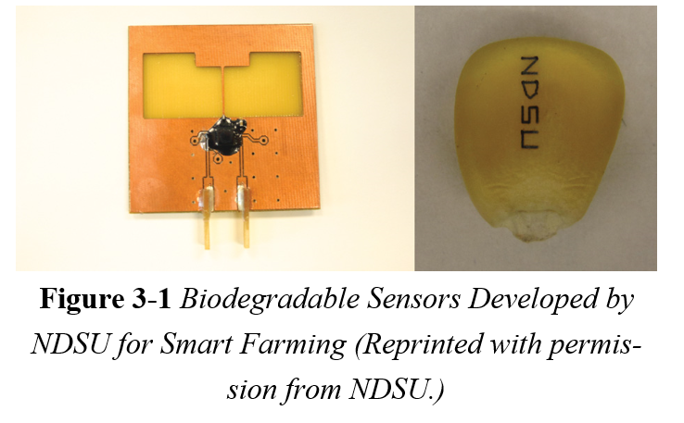
Sensors
shows biodegradable, passive microsensors to measure soil and crop and conditions. These sensors, developed at North Dakota State University (NDSU), can be planted directly in the soil and left in the ground to biodegrade without any harm to soil quality.

Slide 8
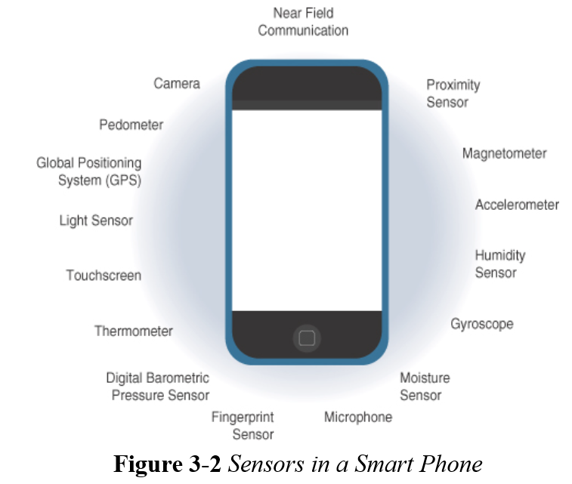
Sensors

Slide 9
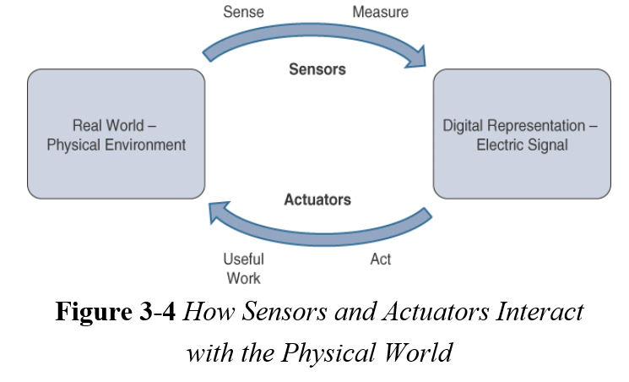
Actuators
Actuators are natural complements to sensors
Actuators, receive control signal (such as electric signal or digital command) that triggers a physical effect, usually some type of motion, force, and so on.

Slide 10
Actuators
IoT sensors are devices that sense and measure the physical world and signal their measurements as electric signals sent to some type of microprocessor or microcontroller for additional processing.
Correspondingly, a processor can send an electric signal to an actuator that translates the signal into some type of movement (linear, rotational, and so on) or useful work that changes or has a measurable impact on the physical world.
This interaction between sensors, actuators, and processors and the similar functionality in biological systems is the basis for various technical fields, including robotics and biometrics.

Slide 11
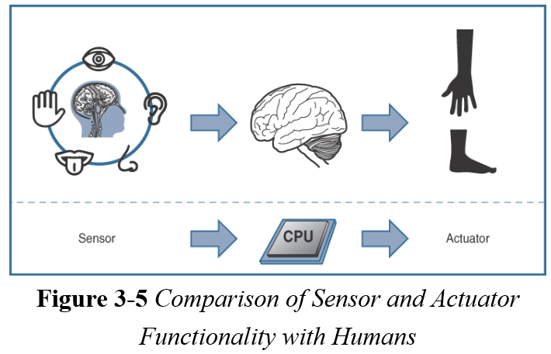
Actuators

Slide 12
Actuators
Actuators also vary greatly in function, size, design,
Classification of Actuators
Type of motion
based on the type of motion they produce. For example, linear, rotary, one/two/three-axes.
Power
based on their power output. For example, high power, low power, micro power
Binary or continuous
based on the number of stable-state outputs.
Area of application
based on the specific industry or vertical where they are used.
Type of energy
based on their energy type

Slide 13
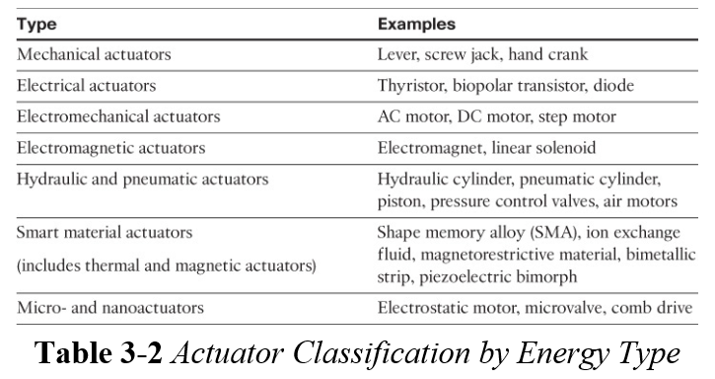
Actuators
Classification based on energy type

Slide 14
Connecting Smart Objects
“IoT Access Technologies,” provides an in-depth look at some of the technologies that are considered when connecting smart objects.
IEEE 802.15.4:
highlights IEEE 802.15.4, the foundational wireless protocol for connecting smart objects.
IEEE 802.15.4g and IEEE 802.15.4e:
discusses improvements to 802.15.4 that are targeted to utilities and smart cities deployments.
IEEE 1901.2a:
discusses IEEE 1901.2a, which is a technology for connecting smart objects over power lines.

Slide 15
Connecting Smart Objects
“IoT Access Technologies,” provides an in-depth look at some of the technologies that are considered when connecting smart objects.
IEEE 802.11ah:
discusses IEEE 802.11ah, a technology built on the well-known 802.11 Wi-Fi standards that is specifically for smart objects.
LoRaWAN:
discusses LoRaWAN, a scalable technology designed for longer distances with low power requirements in the unlicensed spectrum.
NB-IoT and Other LTE Variations:
discusses NB-IoT and other LTE variations, which are often the choice of mobile service providers looking to connect smart objects over longer distances in the licensed spectrum.

Slide 16
Communications Criteria
1) Range
How far does the signal need to be propagated?
What will be the area of coverage for a selected wireless technology?
Should indoor versus outdoor deployments be differentiated?
Based on the above questions the technologies can be categorized into following ranges -

Slide 17
Short range:
The wired example is a serial cable.
Wireless short-range technologies are an alternative to a serial cable, supporting tens of meters of maximum distance between two devices.
Examples of short-range wireless technologies are IEEE 802.15.1 Bluetooth and IEEE 802.15.7 Visible Light Communications (VLC).
Not used in many IoT applications, as they are not mature enough for production deployment.

Slide 18
Medium range:
Is the main category of IoT access technologies.
In the range of 10 to 100mts, many specifications and implementations are available.
The maximum distance is less than 1 mile between two devices
Examples of medium-range wireless technologies include
IEEE 802.11 Wi-Fi, IEEE 802.15.4, and 802.15.4g WPAN.
Examples of Wired technologies include
IEEE 802.3 Ethernet and IEEE 1901.2 Narrowband Power Line Communications (PLC) may be classified as medium range, depending on their physical media characteristics.

Slide 19
Long range:
Distances greater than 1 mile between two devices require long-range technologies.
Wireless examples are cellular (2G, 3G, 4G) and some applications of outdoor IEEE 802.11 Wi-Fi and Low-Power Wide- Area (LPWA) technologies.
LPWA communications have the ability to communicate over a large area without consuming much power.
Found in industrial networks, IEEE 802.3 over optical fiber and IEEE 1901 Broadband Power Line Communications are classified as long range but are not really considered IoT access technologies.

Slide 20
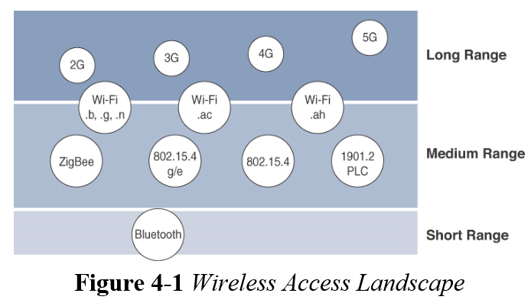
Communications Criteria: Range

Slide 21
Communications Criteria: Frequency Bands
Radio spectrum is regulated by countries and/or organizations, such as the International Telecommunication Union (ITU) and the Federal Communications Commission (FCC).
These groups define the regulations and transmission requirements for various frequency bands.
Eg - Portions of the spectrum are allocated to types of telecommunications such as radio, television, military, and so on.
Focusing on IoT access technologies, the frequency bands for wireless communications are split between licensed and unlicensed bands.

Slide 22
licensed spectrum
IoT access infrastructures that wish to utilize licensed spectrum the users must subscribe to services when connecting their IoT devices.
Disadvantage
adds more complexity to a deployment involving large numbers of sensors and other IoT devices
Advantage:
Network operator can guarantee the frequency usage over the target area and can sell better guarantee of service
Licensed spectrum is applicable to IoT long-range access technologies and allocated to communications infrastructures deployed by services providers, public services (eg-first responders, military), broadcasters, and utilities.

Slide 23
Unlicensed spectrum
Unlicensed means that no guarantees or protections are offered in the ISM bands for device communications.
The ITU has also defined unlicensed spectrum for the industrial, scientific, and medical (ISM) portions of the radio bands.
These frequencies are used in many communication technologies for short-range devices (SRDs)
For IoT access, these are the most well-known ISM bands:
2.4 GHz band as used by IEEE 802.11b/g/n Wi-Fi
IEEE 802.15.1 Bluetooth
IEEE 802.15.4 WPAN

Slide 24
Unlicensed bands are not unregulated as National and regional regulations exist for each of the allocated frequency bands
These regulations mandate device compliance on parameters such as transmit power, duty cycle and dwell time, channel bandwidth, and channel hopping.
Some communications within the ISM bands operate in the sub-GHz range.
Sub-GHz bands are used by protocols such as IEEE 802.15.4, 802.15.4g, and 802.11ah, and LPWA technologies such as LoRa and Sigfox.
sub-GHz frequency bands allow greater distances between devices.

Slide 25
These bands have a better ability to penetrate building infrastructures or go around obstacles, while keeping the transmit power within regulation.
The disadvantage of sub-GHz frequency bands is their lower rate of data delivery compared to higher frequencies.
Sub-GHz ranges have been defined by ISM band are 169 MHz, 433 MHz, 868 MHz, and 915 MHz used in common.
Most IoT access technologies tend to focus on the two sub-GHz frequency regions around 868 MHz and 915 MHz.
These main bands are commonly found throughout the world and are applicable to nearly all countries.

Slide 26
Communications Criteria: Power Consumption
Powered nodes
A powered node has a direct connection to a power source, and communications are not limited by power consumption criteria.
ease of deployment of powered nodes is limited by the availability of a power source, which makes mobility more complex.
Battery-powered nodes.
These nodes bring more flexibility to IoT devices.
They have lifetimes for their batteries
They are often placed in a “sleep mode” to preserve battery life when not transmitting.
For battery-powered nodes, the topology type and the role of the node in the topology (i.e., being an intermediate or leaf node) are significant factors for a successful implementation.
IoT wireless access technologies must address the needs of low power consumption and connectivity for battery-powered nodes.

Slide 27
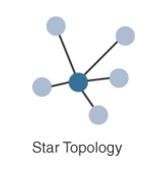
Communications Criteria: Topology
Three main topology schemes are dominant: star, mesh, and peer-to-peer.
Star topologies utilize a single central base station or controller to allow communications with endpoints.
For long-range and short-range technologies, a star topology is common, as seen with cellular, LPWA, and Bluetooth networks.

Slide 28
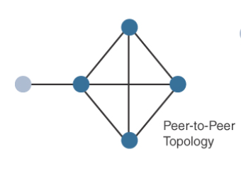
Peer-to-peer topologies allow any device to communicate with any other device as long as they are in range of each other.
For medium-range technologies, a star, peer-to-peer, or mesh topology is common
Peer-to-peer topologies rely on multiple full-function devices.

Slide 29
A mesh topology helps cope with low transmit power, searching to reach a greater overall distance, and coverage by having intermediate nodes relaying traffic for other nodes.
Mesh topology requires the implementation of a Layer 2 forwarding protocol known as mesh-under or a Layer 3 forwarding protocol referred to as mesh-over on each intermediate node.

Slide 30
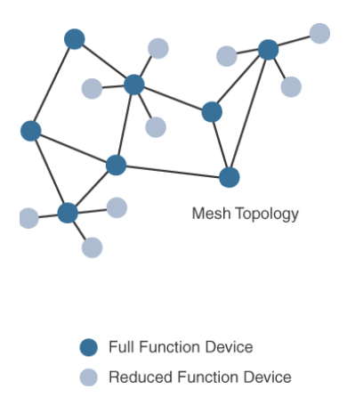
Full-function device (FFD) is a node that interconnects other nodes.
A node that doesn’t interconnect or relay the traffic of other nodes is known as a leaf node, or reduced-function device (RFD).

Slide 31
Communications Criteria: Constrained Devices
Constrained nodes have limited resources that impact their networking feature set and capabilities .
Classes of constrained nodes
Class 0:
Fully constrained with <10KB of memory and <100KB of flash processing and storage capability.
Nodes are battery powered.
They do not have resources required to implement IP stack and associated security mechanisms.
eg – push button

Slide 32
Class 1:
Approx 10KB RAM and Approx 100KB Flash.
Helps provide support for security functions to implement an optimized IP stack with help of appropriate protocols like CoAP.
Eg- environmental sensors
Class 2:
Characterized by running full implementation of an IP stack on embedded devices
Contains more than 50KB of memory and 250KB of Flash which can be fully integrated in IP network
Eg – smart power meter

Slide 33
Communications Criteria: Constrained-Node Networks
Constrained-node networks are referred to as low-power and lossy networks (LLNs).
Low-power of LLNs refers to the fact that nodes must cope with the requirements from powered and battery-powered constrained nodes.
Lossy networks indicates that network performance may suffer from interference and variability due to harsh radio environments.
Layer 1 and Layer 2 protocols that can be used for constrained-node networks must be evaluated in the context of the following characteristics for use-case applicability:
Data rate and Throughput,
Latency and Determinism, and
Overhead and payload.

Slide 34
Data Rate and Throughput
The data rates available from IoT access technologies range from 100 bps with protocols such as Sigfox to tens of megabits per second with technologies such as LTE and IEEE 802.11ac.
Short-range technologies can also provide medium to high data rates that have enough throughput to connect a few endpoints like Bluetooth.
The IoT access technologies developed for constrained nodes are optimized for low power consumption,
They are also limited in terms of data rate, which depends on
The selected frequency band, and throughput.

Slide 35
Latency and Determinism
For IoT applications latency expectations should be known when selecting an access technology.
In constrained networks, latency may range from a few milliseconds to seconds, and applications and protocol stacks must cope with these wide-ranging values.
eg – UDP is strongly recommended for IP endpoints communicating over LLNS

Slide 36
Overhead and Payload
It is important to review the MAC payload size characteristics required by applications.
The minimum IPv6 MTU size is expected to be 1280 bytes.
The fragmentation of the IPv6 payload has to be taken into account by link layer access protocols with smaller MTUs.
Small payload sizes are defined to cope with the low data rate and time over the air or duty cycle requirements of IoT nodes and sensors.

Slide 37
IoT Access Technologies
Topics addressed for each IoT access technology:
Standardization and alliances:
The standards bodies that maintain the protocols for a technology
Physical layer:
The wired or wireless methods and relevant frequencies
MAC layer:
Considerations at the Media Access Control (MAC) layer, which bridges the physical layer with data link control
Topology:
The topologies supported by the technology
Security:
Security aspects of the technology
Competitive technologies:
Other technologies that are similar and may be suitable alternatives to the given technology

Slide 38
IoT Access Technologies: LoRaWAN
Standardization and Alliances
LoRa was developed by a French company named Cycleo, Later, Cycleo was acquired by Semtech.
Optimized for long-range, two-way communications and low power consumption
Technology evolved from Layer 1 to a broader scope through the creation of the LoRa Alliance.
The LoRa Alliance quickly achieved industry support and currently has hundreds of members.
The LoRa Alliance uses the term LoRaWAN to refer to its architecture and its specifications that describe end-to-end LoRaWAN communications and protocols.

Slide 39
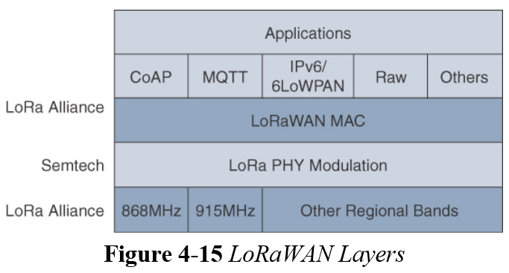
IoT Access Technologies: LoRaWAN
Standardization and Alliances
LoRa Alliance handles the MAC layer and regional frequency bands.

Slide 40
IoT Access Technologies: LoRaWAN
Physical Layer
Semtech LoRa modulation is based on chirp spread spectrum modulation, which trades a lower data rate for receiver sensitivity to significantly increase the communication distance.
it allows demodulation below the noise floor, offers robustness to noise and interference, and manages a single channel occupation by different spreading factors.
LoRaWAN 1.0.2 regional specifications describe the use of the main unlicensed sub-GHz frequency bands of 433 MHz, 779–787 MHz, 863–870 MHz and 902–928 MHz, as well as regional profiles for a subset of the 902–928 MHz bandwidth.

Slide 41
IoT Access Technologies: LoRaWAN
Physical Layer
A LoRa gateway is deployed as the center hub of a star network architecture.
serve as a transparent bridge relaying data between endpoints, and the endpoints use a single-hop wireless connection to communicate with one or many gateways.
The data rate in LoRaWAN depends on
Frequency bands and
Adaptive data rate (ADR).
ADR is an algorithm that manages the data rate and radio signal for each endpoint.
It ensures that packets are delivered at the best data rate possible and that network performance is both optimal and scalable.

Slide 42
IoT Access Technologies: LoRaWAN
Physical Layer
An important feature of LoRa is its ability to handle various data rates via the spreading factor.
SF(spreading factor) provides slower transmission rates but achieves a higher reliability at longer distances.

Slide 43
IoT Access Technologies: LoRaWAN
MAC Layer
The LoRaWAN specification documents three classes of LoRaWAN devices:
Class A:
Optimized for battery-powered nodes, it allows bidirectional communications, where a given node is able to receive downstream traffic after transmitting.
Two receive windows are available after each transmission.
Class B:
A Class B node or endpoint should get additional receive windows compared to Class A, but gateways must be synchronized through a beaconing process.
Class C:
This class is particularly adapted for powered nodes. This classification enables a node to be continuously listening keeping its receive window open when not transmitting.

Slide 44
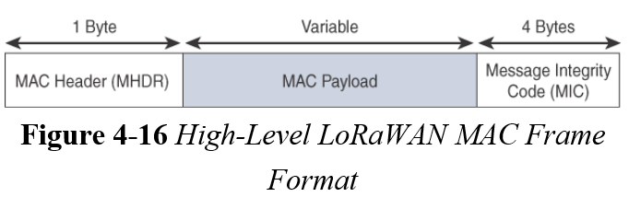
IoT Access Technologies: LoRaWAN
MAC Layer
composed of a
1-byte MAC header,
a variable-byte MAC payload, and
a MIC that is 4 bytes in length.

Slide 45
IoT Access Technologies: LoRaWAN
MAC Layer
1.0.x LoRaWAN utilizes six MAC message types.
LoRaWAN devices use join request and join accept messages for over-the-air (OTA) activation and joining the network.
The other message types are unconfirmed data up/down and confirmed data up/down.
Uplink messages are sent from endpoints to the network server and are relayed by one or more LoRaWAN gateways.
Downlink messages flow from the network server to a single endpoint and are relayed by only a single gateway.

Slide 46
IoT Access Technologies: LoRaWAN
Topology
“star of stars” topology.
the infrastructure consists of endpoints exchanging packets through gateways acting as bridges, with a central LoRaWAN network server.
Gateways connect to the backend network using standard IP connections, and endpoints communicate directly with one or more gateways.

Slide 47
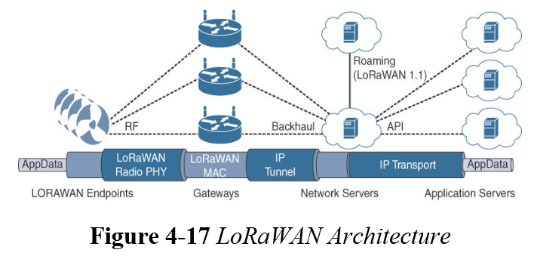
IoT Access Technologies: LoRaWAN
Topology
LoRaWAN gateways act as bridges that relay between endpoints and the network servers.
Multiple gateways can receive and transport the same packets.
When duplicate packets are received, de-duplication is a function of the network server.

Slide 48
IoT Access Technologies: LoRaWAN
Topology
Network server manages the data rate and radio frequency (RF) of each endpoint through the adaptive data rate (ADR) algorithm.
Forwards application data to the application servers.

Slide 49
IoT Access Technologies: LoRaWAN
Security
LoRaWAN endpoints must implement two layers of security, protecting communications and data privacy across the network.
The first layer, called “network security” but applied at the MAC layer, guarantees the authentication of the endpoints by the LoRaWAN network server.
It protects LoRaWAN packets by performing encryption based on AES.
The second layer is an application session key (AppSKey), which performs encryption and decryption functions between the endpoint and its application server.

Slide 50
IoT Access Technologies: LoRaWAN
The term LoRa refers to the PHY layer, and LoRaWAN focuses on the architecture, the MAC layer, and a unified, single standard for seamless interoperability.
LoRaWAN is managed by the LoRa Alliance, an industry organization.
The PHY and MAC layers allow LoRaWAN to cover longer distances with a data rate that can change depending on various factors.
The LoRaWAN architecture depends on gateways to bridge endpoints to network servers.
From a security perspective, LoRaWAN offers AES authentication and encryption at two separate layers.

